Slide 1
Cultural analysis and leadership effectiveness in Disruptive times Does the Nordic have some of the solutions?
Author: Michele Guarini

Slide 2
In Denmark some of us ask
How can we defend the values that our community build on?
What do we learn in our schools?
Will we loose our game in the light of developments?
What are some of the reasons that we have such a nice place here?
How can we export that and should we?

Slide 3
"When in Rome do as the Romans do."
Leader effectiveness is contextual, that is, it is embedded in the societal and organizational norms, values, and beliefs of the people being led.
But are we so different?
Notes:
In other words, to be seen as effective, the time-tested adage continues to apply: As a first step to gauge leader effectiveness across cultures, GLOBE empirically established nine cultural dimensions that make it possible to capture the similarities and/or differences in norms, values, beliefs –and practices—among societies.
They build on findings by Hofstede (1980), Schwartz (1994), Smith (1995), Inglehart (1997), and others.

Slide 4
Leader Effectiveness and Culture: The GLOBE Study
Cultural Dimensions and Culture Clusters
GLOBE established nine cultural dimensions that make it possible to capture the similarities and/or differences in norms, values, beliefs –and practices—among societies.

Slide 5
Power Distance | The degree to which members of a collective expect power to be distributed equally
Uncertainty Avoidance | The extent to which a society, organization, or group relies on social norms, rules, and procedures to alleviate unpredictability of future events.
Humane Orientation | The degree to which a collective encourages and rewards individuals for being fair, altruistic, generous, caring, and kind to others.
Collectivism I (Institutional) | The degree to which organizational and societal institutional practices encourage and reward collective distribution of resources and collective action.
Collectivism II (In-Group) | The degree to which individuals express pride, loyalty, and cohesiveness in their organizations or families.
Assertiveness | The degree to which individuals are assertive, confrontational, and aggressive in their relationships with others.
Gender Egalitarianism | The degree to which a collective minimizes gender inequality.
Future Orientation | The extent to which individuals engage in future-oriented behaviors such as delaying gratification, planning, and investing in the future.
Performance Orientation | The degree to which a collective encourages and rewards group members for performance improvement and excellence.
Categories build on findings by Hofstede (1980), Schwartz (1994), Smith (1995), Inglehart (1997), and others.
Notes:
Power distance refers to the extent to which a collective maintains inequality among its members by stratifying in-dividuals and groups with respect to power, authority, and prestige (sample item: 'Followers are (should be) expected to obey their leaders without question.'). The range of scores for both practices and values is from 1 (very low) to 7 (very high). A score of 2 means low practices or values of power distance; a score of 6 means high practices or values. The vertical axis represents cultural practices (As Is) and the horizontal axis represents cultural values (Should Be). Note that in Figure 1 the scores ascribed to practices of power distance (As Is) range between 4 (medium) and 6 (high), whereas the scores ascribed to values of power distance (Should Be) range between 2 (low) and 4 (medium). Thus, in all studied countries power distance is less valued than it is actually practiced.

Slide 6
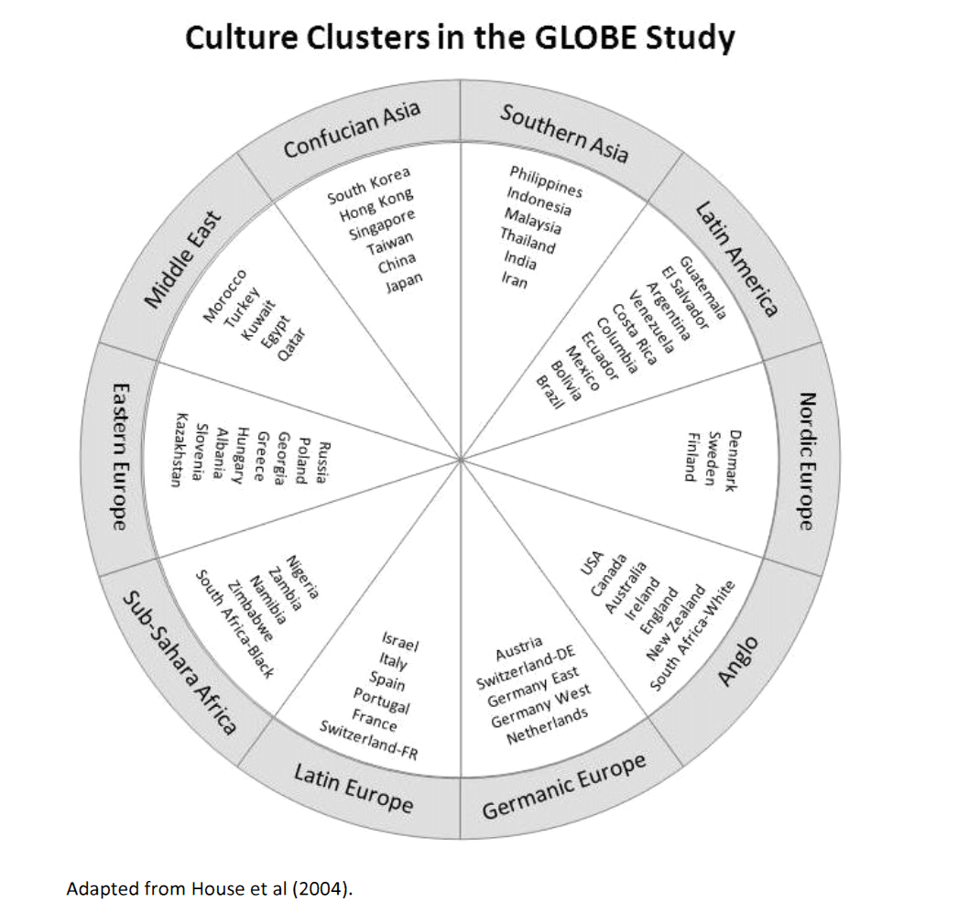

Slide 7
Power Distance | The degree to which members of a collective expect power to be distributed equally
Uncertainty Avoidance | The extent to which a society, organization, or group relies on social norms, rules, and procedures to alleviate unpredictability of future events.
Humane Orientation | The degree to which a collective encourages and rewards individuals for being fair, altruistic, generous, caring, and kind to others.
Collectivism I (Institutional) | The degree to which organizational and societal institutional practices encourage and reward collective distribution of resources and collective action.
Collectivism II (In-Group) | The degree to which individuals express pride, loyalty, and cohesiveness in their organizations or families.
Assertiveness | The degree to which individuals are assertive, confrontational, and aggressive in their relationships with others.
Gender Egalitarianism | The degree to which a collective minimizes gender inequality.
Future Orientation | The extent to which individuals engage in future-oriented behaviors such as delaying gratification, planning, and investing in the future.
Performance Orientation | The degree to which a collective encourages and rewards group members for performance improvement and excellence.
Categories build on findings by Hofstede (1980), Schwartz (1994), Smith (1995), Inglehart (1997), and others.
Notes:
Power distance refers to the extent to which a collective maintains inequality among its members by stratifying in-dividuals and groups with respect to power, authority, and prestige (sample item: 'Followers are (should be) expected to obey their leaders without question.'). The range of scores for both practices and values is from 1 (very low) to 7 (very high). A score of 2 means low practices or values of power distance; a score of 6 means high practices or values. The vertical axis represents cultural practices (As Is) and the horizontal axis represents cultural values (Should Be). Note that in Figure 1 the scores ascribed to practices of power distance (As Is) range between 4 (medium) and 6 (high), whereas the scores ascribed to values of power distance (Should Be) range between 2 (low) and 4 (medium). Thus, in all studied countries power distance is less valued than it is actually practiced.

Slide 8
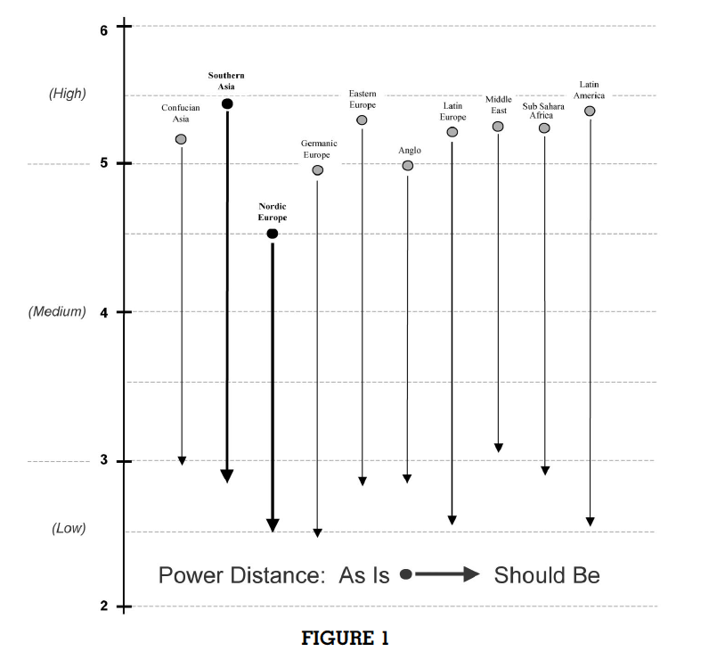
Notes:
Russia – President
They want to see a strong decisive manager/leader
What works and what does not

Slide 9
New Nordic Leadership
“Scandinavian management is characterized by being participatory, trust-oriented and dialogue-based, where the delegation, participation and respect for diversity are prevalent values​​.”
Notes:
Research shows that leadership communicates clear direction involves and explains decisions predisposing to experienced trust, justice and meaning, creating greater strategic decision-making and implementation quality, which in turn predisposes to greater organizational effectiveness.
Set in a larger, global perspective, we consider the Fair Management as a proposed model for the New Nordic Leadership.

Slide 10
Future Leadership needs
How do we identify the future leaders
Exponential growth in complexity
Enormous demand on agility
New ways to organize to solve problems
Less hierarchical
Agile projects (Agile teams)
Continuous improvement
Traditional projects are impossible
Test, priorities and evaluations
Time to market
Performance management in Organizations

Slide 11
Organizations as we know them are gone
The key question is
How do we build sustainable organizations or communities in the future?
Public sector
Privat sector
Political leadership
schools, Universities and continuous education

Slide 12
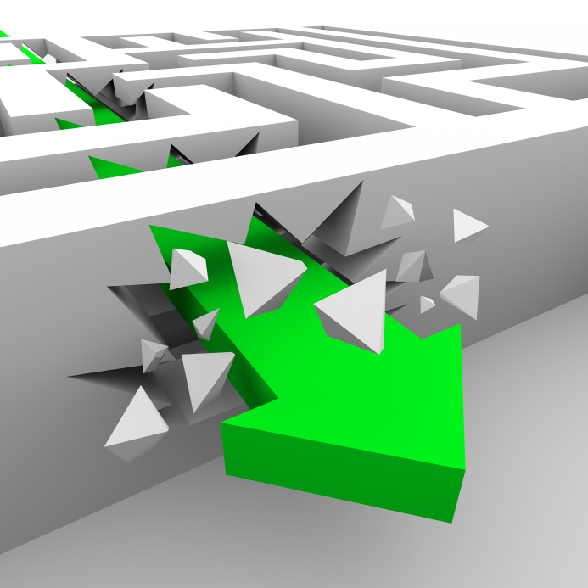
Disruptive times

Slide 14
A framework for defining Talent
Trends in the environment that surround
Organisational strategy
Required organizational capabilities*
Current Organisational Capabilities
Current People Challenges
Talent priorities
Adapted from Ulrick & brockbank
* Defined as not only the skills required, but also how people collectively need to behave (eg. org values)

Slide 15
A big research from a Danish international
The burning question from the CEO was
Why does nothing happen?
Strategy implementation
Change of behavior
Key research questions were
Is it a Level or Silo issue
Identify the key driver or blockers for change and agility

Slide 16
OE is driven by the managers ability to empower
.44** | Time, dedication to support learning and development
.37** | Creates on the job learning opportunities
.42** | Makes sure that individuals know what is expected of them
.46** | Provides clear feedback on performance
.46** | Regularly evaluates personal development progress
.42** | Measures results or develops KPIs on relevant matters, cuts back on irrelevant reporting.

Slide 17
Empowerment project
**

Slide 18
Where did we find LeadershipEmpowerment?
CEO
CFO
bg
COO
hk
CIT
vg

Slide 19
How to regroup?

Slide 20
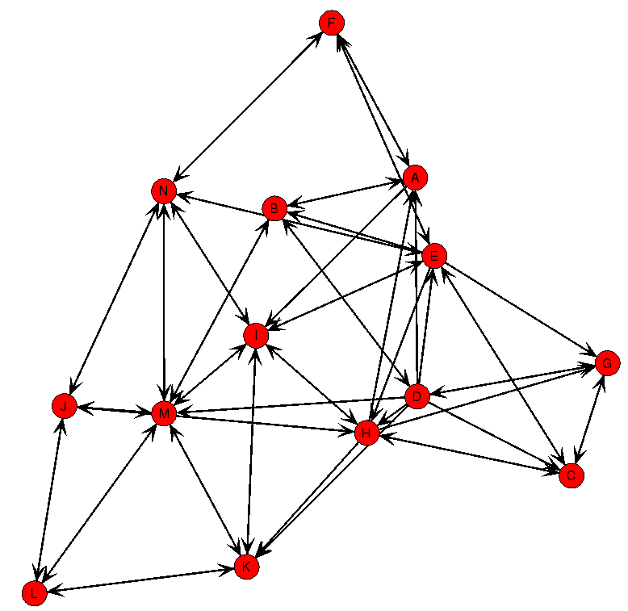
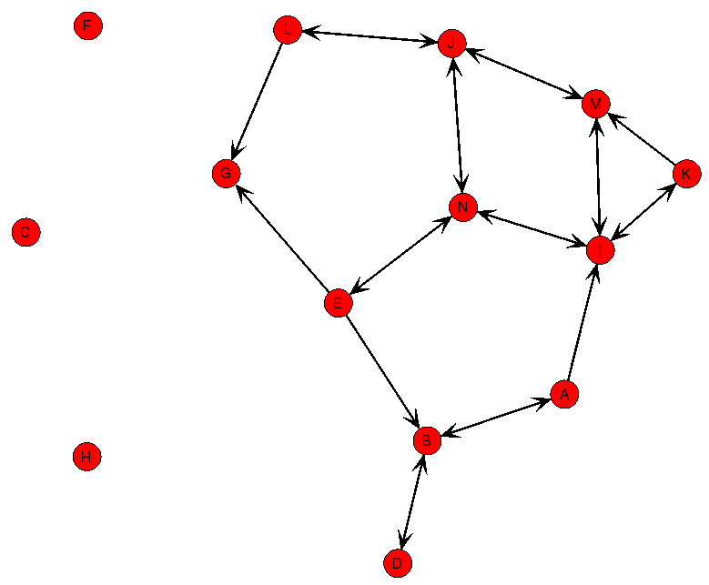
High performing teams have a richer set of connections and less centralization
Low Performing Team
High Performing Team
Page 11

Slide 21
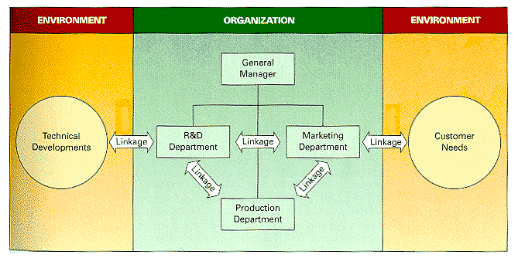
But much important work in organizations involves coordination of activities across the groups’ boundaries

Slide 22
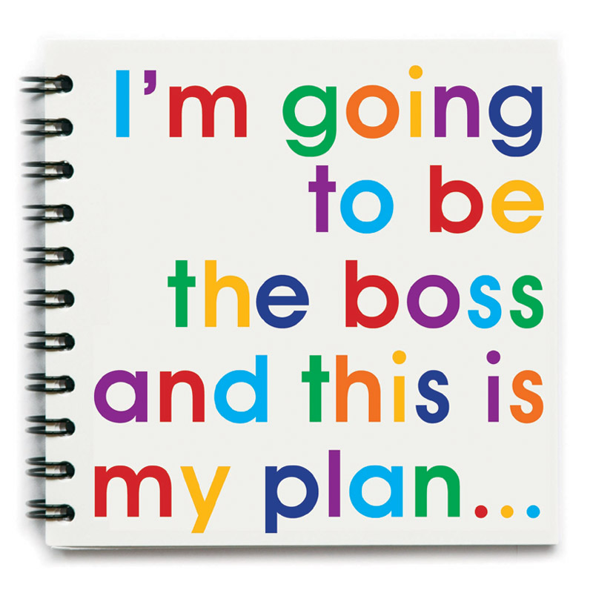
Such coordination can’t always be commanded and may not be based on authority

Slide 23
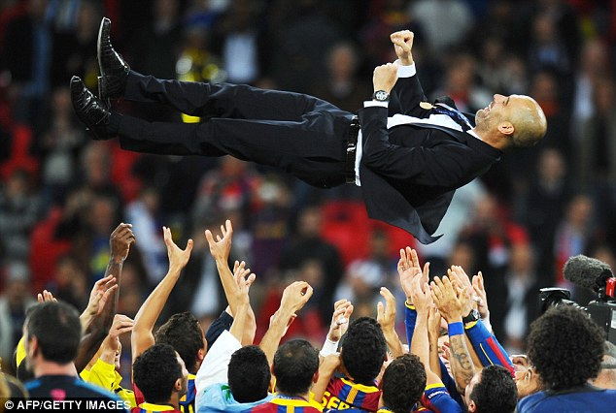
Instead, it is often based on voluntary and reciprocal relationships like trust, advice-seeking, knowledge-sharing, motivation, friendship, etc.

Slide 24
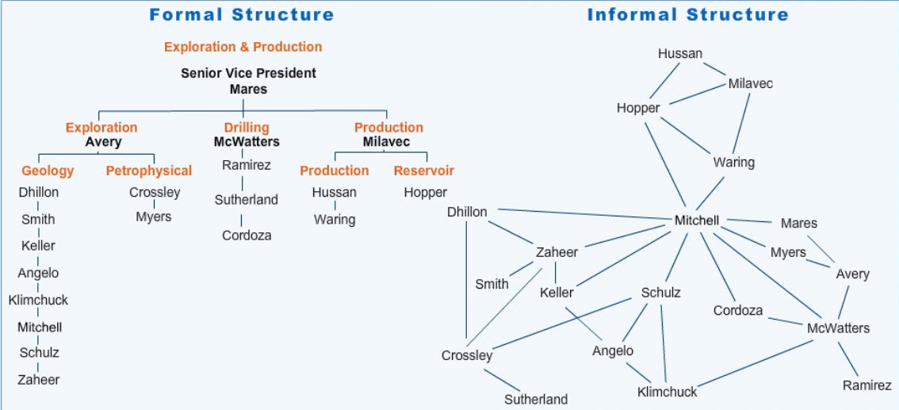
Position in the formal hierarchy is a poor predictor of who is most influential in networks based on these relationships.

Slide 25
Position in the formal hierarchy is a poor predictor of who is most influential in networks based on these relationships.

Slide 26
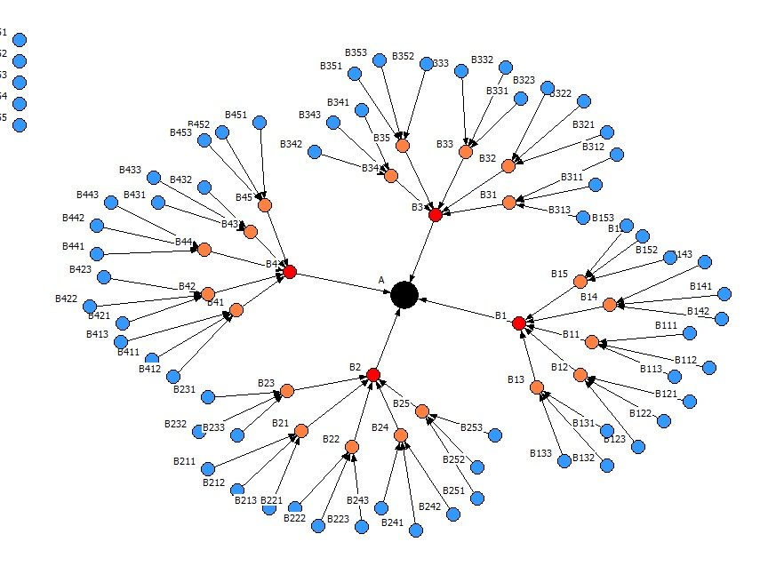

Slide 27
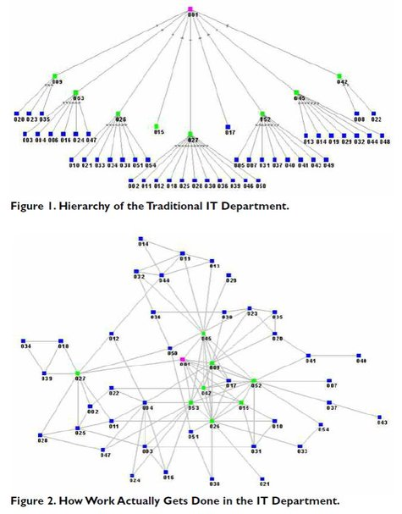
Finding & Diagnosing Your Organization’s Informal Networks

Slide 28
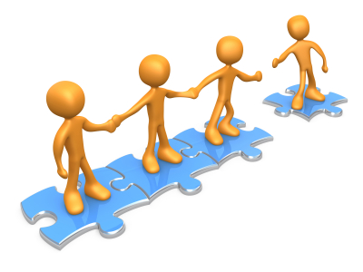
Notes:
These groups could represent different functions, departments, business units, processes, geographical regions, levels in the hierarchy, other organizations, as well as, gender, tenure, and other demographic variables.

Slide 29
”I have in the past 2 years experiences a larger change process or reorganization in my workplace”
74 % agree
70% of all
strategic / change processes fail
Mckinsey Quarterly(2008):Creating Organizational Transformattion.
McKinsey Global Survey Results (2010): What Succesful Transformations Share.

Slide 30
principles and dynamics
Management
experience
Behavior
Set context
Involve appropriatly
Explain decisions
trust
justice
opinion
Willingness to share knowledge, develop ideas / solutions and implement strategies
In the event of breach of either of the
three management principles
Loss of trust
Loss of ownership
Loss of dedication
Reluctant to share knowledge, develop ideas / solutions and implement strategies
Notes:
De grundlæggende principper i vores strategiske procesdesign for Fair Ledelse er; 1) sæt klar retning og ramme for den strategiske indsats, 2) involver i beslutningsprocesser, der er præget af mental fleksibilitet og koordinerende dialog, 3) forklar overvejelser og kriterier for at træffe strategiske beslutninger. Disse principper disponerer for en positiv dynamik, hvor medarbejderne oplever tillid, ejerskab og mening, der igen disponerer for medarbejderhandlinger præget af proaktiv villighed til at dele viden, udvikle løsninger og implementere ledelsens strategiske beslutninger.

Slide 31
design 3
Management provides the context and ask openly employees to develop solutions.
Co-creation
INVOLVEMENT & OWNERSHIP
CONTROL & MANAGEMENT
design 2
Management provides the context and makes
X number of proposed solutions, and asking employees to qualify them
Information
design 1
Management only set the context and decides the solution.

Slide 32
Empowerment project
**

Slide 33
Company performance predictors
Correlation
 | N | E | O | A | C
Trust |  |  |  |  | 0,313
Empowerment | -0,251 | 0,311 |  | 0,274 | 0,274
Honesty |  | 0,293
Responsibility |  |  |  | 0,288 | 0,409
Efficiency |  | 0,244 |  | 0,311 | 0,201
Passion |  | 0,401 |  |  | 0,240
Entrepreneurship
Notes:
Big differences in the contextual surconstandings

Slide 34
Our Questions
Early tendencies in new trends in performance
Who gets there and who stays there?
Performance optimization
Understanding change effects

Slide 35
523 Advisors rated by 34 Team Leaders
– observed behaviours
OBSERVED
BEHAVIOURS
SCALE 1-7

Slide 36
Drivers of success/Competencies in department are
Customer Centric **
Learning Ability **
Resilience **

Slide 37
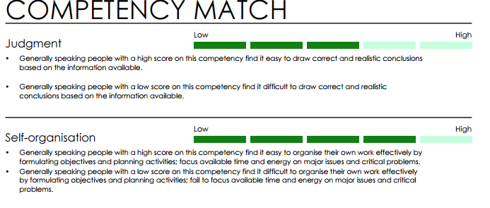

Slide 38
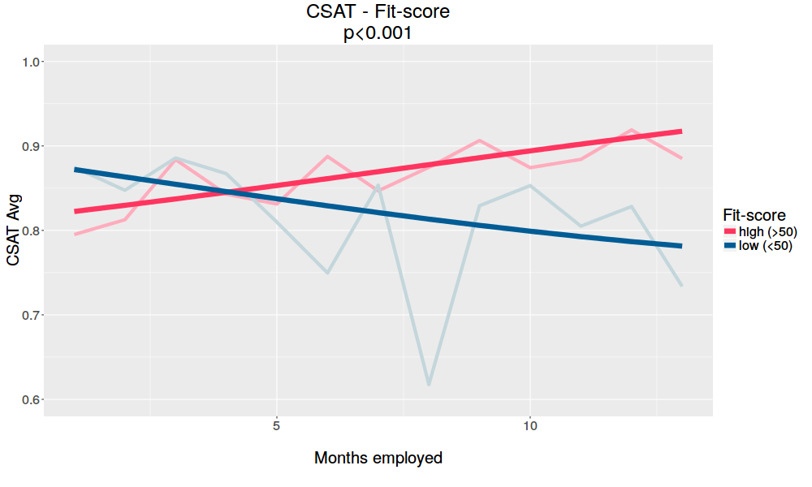
Individuals who will grow in the right direction

Slide 39
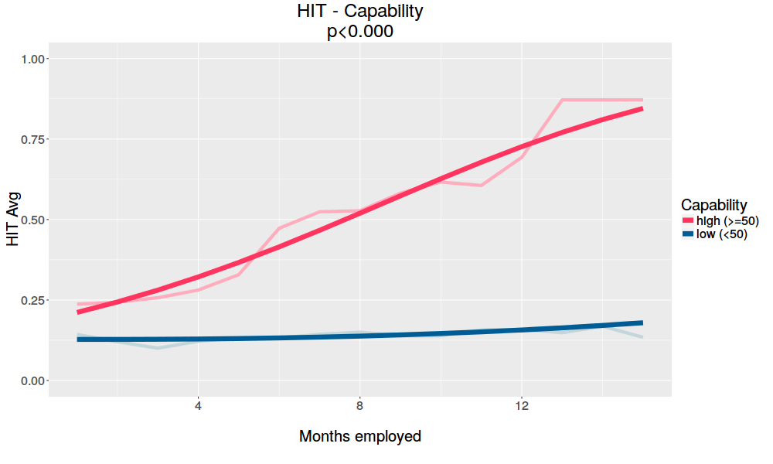
Notes:
cdg: "-e5","o4","-c3"
This graph shows the contrast between our fit-score and our capability score. Here we show that is possible to charaterize high performers in terms of Big 5 facets. This is a data driven model which aims to identify characteristics of high performers in order to use this knowledge in later tests

Slide 40
Change of culture in organization
What is organizational culture?
It is the working memory of the organization
The stronger the memory the harder the change
We identify the new role models already imbedded in the organization
Notes:
The Neurotic organisation

Slide 41
Thank you
Questions?

